Slide 1

Organisation overview
Suemon Kwok | Student ID: 14883335 | Assignment 1 Presentation

Slide 2
Business requirement
System that tracks highest microtransactions sales
For various cosmetics items for character classes, weapons, armour etc
Track the demographics and region
Underperforming statistics
Suemon Kwok | Student ID: 14883335 | Assignment 1 Presentation

Slide 3
Key Functional and non requirements
Functional Requirements
Non-Functional Requirements
FR01
Transaction Capture
NFR01
Performance
Records every purchase with item ID, price, timestamp, and player account
Each purchase event processed and stored within 2 seconds of completion
FR09
Filterable Reports
NFR03
Legal / Privacy
Reports filterable by date range, region, item type, and character class
All player data collected and stored in compliance with the NZ Privacy Act 2020
FR11
Underperformance Flags
NFR04
Scalability
Automatically flags items whose sales fall below a configurable threshold
System supports a minimum of 50 concurrent internal users without performance degradation
FR12
Export (CSV / PDF / JSON)
NFR05
Dashboard Speed
Authorised users can export report data in three formats for downstream use
Reports render within 3 seconds when querying datasets of up to 1,000,000 records
FR13
Role-Based Access
NFR06
Usability
Four roles — Analyst, Marketing, Finance, Developer — with tailored permissions
Interface operable without formal training by staff familiar with standard dashboards
Suemon Kwok | Student ID: 14883335 | Assignment 1 Presentation

Slide 4
Remaining Functional and Non-Functional Requirements
Functional Requirements (Remaining)
Non-Functional Requirements (Remaining)
FR02
Item Categorisation
NFR02
Availability
Categorises each purchase by item type: weapon skins, armour, pets, portal effects, hideout, stash tabs
System shall maintain 99.9% uptime during peak league launch windows — the highest-demand periods for gameplay and microtransactions
FR03
Character Class Tracking
Records the character class active at time of purchase to enable class-correlated sales analysis
Full Requirements Summary
Functional (14 total):
FR01–FR05 Sales Capture & Transaction Tracking
FR06–FR08 Player Demographics & Segmentation
FR09–FR12 Reporting, Analytics & Export
FR13–FR14 Role-Based Access & Security
Non-Functional (6 total):
NFR01 Performance (2s ingestion)
NFR02 Availability (99.9% uptime)
NFR03 Legal / Privacy (NZ Privacy Act 2020)
NFR04 Scalability (50 concurrent users)
NFR05 Dashboard Speed (3s / 1M records)
NFR06 Usability (no formal training required)
FR05
Bundle vs Individual Tracking
Distinguishes bundle purchases from individual item purchases, recording each transaction type separately
FR06
Regional Purchase Data
Records player geographic region at time of purchase to facilitate regional sales analysis
FR07
Spending Tier Classification
Classifies players as Casual (<$50), Regular ($50-$200), or High-Value (>$200) by lifetime spend | FR08: Tracks repeat vs first-time buyers per item
FR14
Export Permission Enforcement
Restricts data export and system configuration to explicitly authorised roles via RBAC enforcement
Suemon Kwok | Student ID: 14883335 | Assignment 1 Presentation

Slide 5
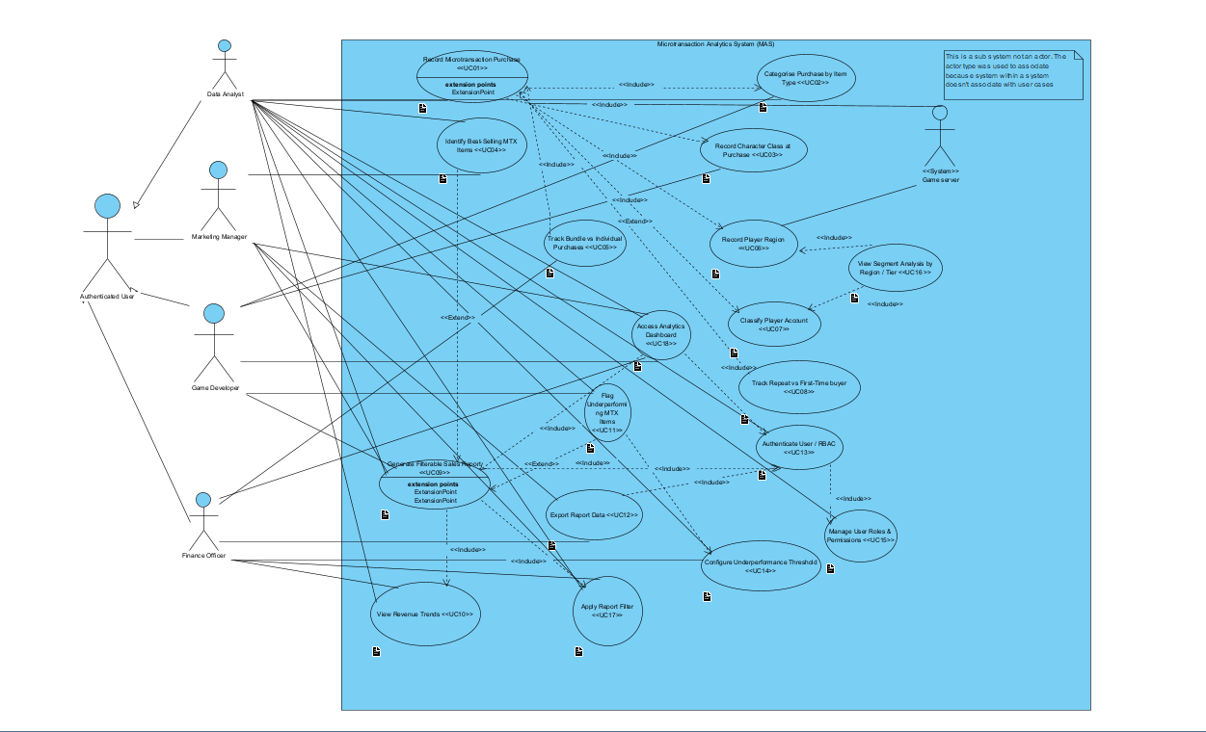
UML Use case diagram (Full 18 use cases)
Suemon Kwok | Student ID: 14883335 | Assignment 1 Presentation

Slide 6
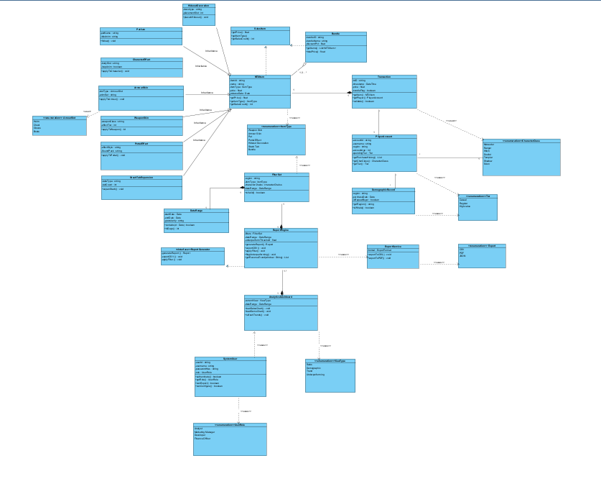
UML Class Diagram (Full classes )

Slide 7
Key Design Decisions / OOP Principles
UML Class / Interface | C# File | OOP Concept Demonstrated
«interface» SalesItem | Models/ISalesItem.cs | Interface; Dependency Inversion (SOLID)
«abstract» MTXItem | Models/MTXItem.cs | Abstraction; Encapsulation (private _price, _salesCount)
WeaponSkin | Models/MTXItemTypes.cs | Inheritance; Polymorphism via ISalesItem
ArmourSkin | Models/MTXItemTypes.cs | Inheritance; ArmourSlot enum dependency
PetItem | Models/MTXItemTypes.cs | Inheritance
PortalEffect | Models/MTXItemTypes.cs | Inheritance
HideoutDecoration | Models/MTXItemTypes.cs | Inheritance
StashTabExpansion | Models/MTXItemTypes.cs | Inheritance
Bundle | Models/MTXItemTypes.cs | Inheritance; Composition (List<MTXItem>)
Transaction | Models/Transaction.cs | Encapsulation; Association; Immutability
DemographicRecord | Models/Transaction.cs | Immutable Value Object; Decoupling pattern
PlayerAccount | Models/PlayerAccount.cs | Encapsulation; HashSet for purchase history
SystemUser | Models/SystemUser.cs | Encapsulation (SHA-256 hash); Principle of Least Privilege
FilterSet / DateRange / Report | Models/ReportModels.cs | Value Objects; Data Transfer Object pattern
«interface» IReportGenerator | Services/IReportGenerator.cs | Interface Segregation; Dependency Inversion
ReportEngine | Services/ReportEngine.cs | Single Responsibility; High Cohesion
TransactionService | Services/TransactionService.cs | Service Layer; Low Coupling via repository interfaces
AuthService | Services/AuthService.cs | Encapsulation; Session management
ExportService | Services/ExportService.cs | Single Responsibility; Strategy-like dispatch

Slide 8
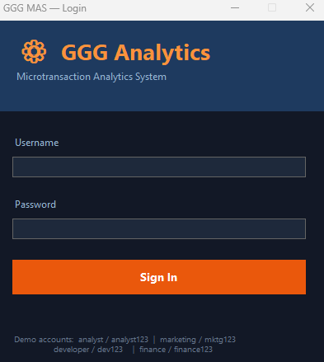
Software Demo - Login interface
Suemon Kwok | Student ID: 14883335 | Assignment 1 Presentation

Slide 9
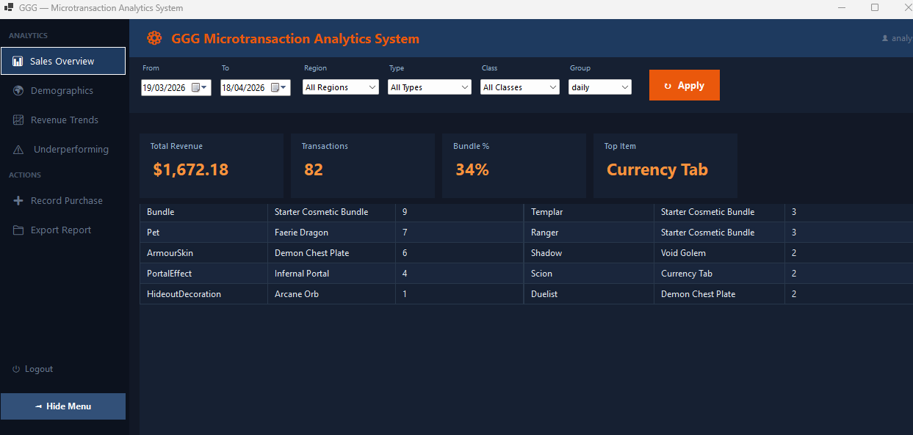
Software Demo – Sales Overview
Suemon Kwok | Student ID: 14883335 | Assignment 1 Presentation

Slide 10
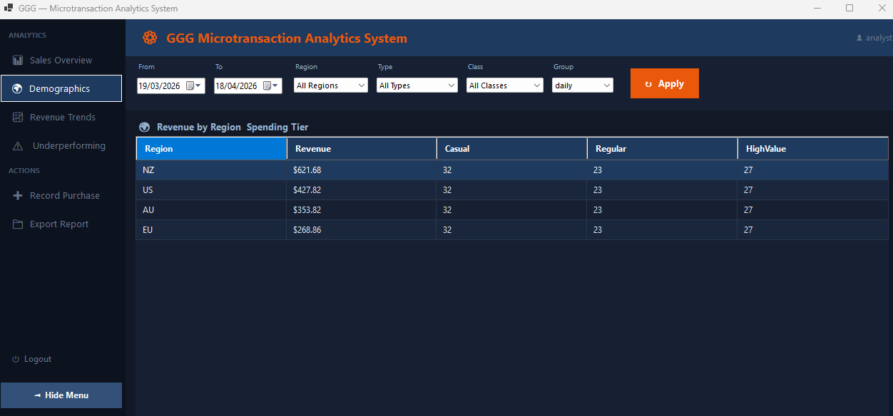
Software Demo - Demographics
Suemon Kwok | Student ID: 14883335 | Assignment 1 Presentation

Slide 11
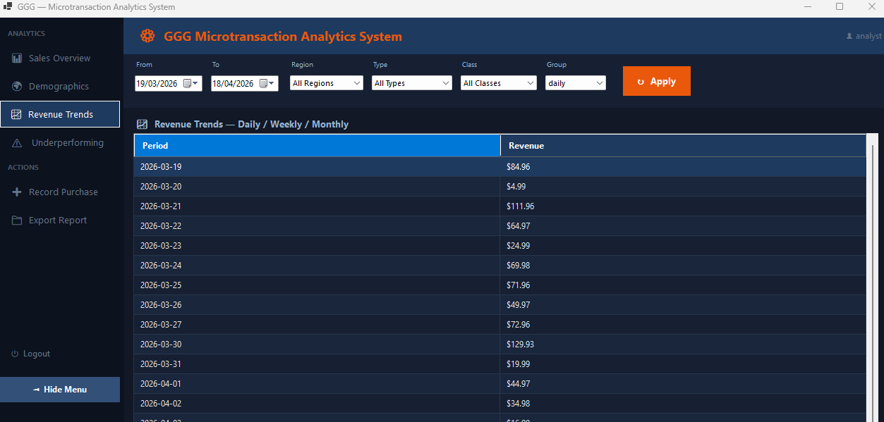
Software Demo - Revenue trend
Suemon Kwok | Student ID: 14883335 | Assignment 1 Presentation

Slide 12
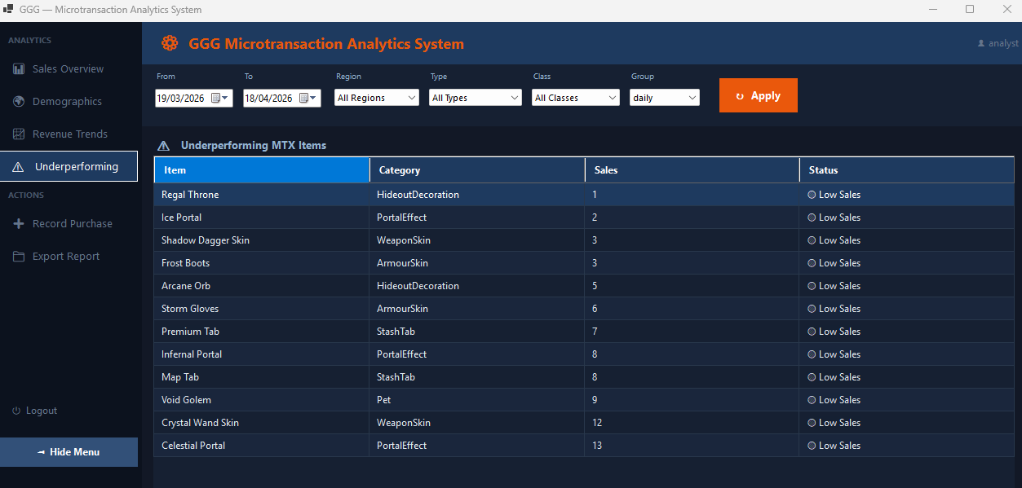
Software Demo - Underperforming
Suemon Kwok | Student ID: 14883335 | Assignment 1 Presentation

Slide 13
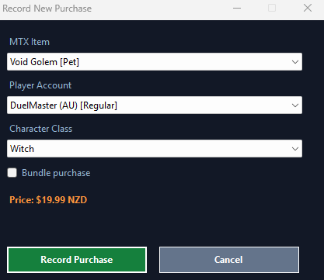
Software Demo – Manual record
Suemon Kwok | Student ID: 14883335 | Assignment 1 Presentation

Slide 14
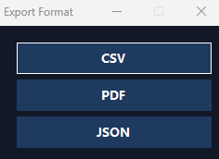
Software Demo - Export formats
Suemon Kwok | Student ID: 14883335 | Assignment 1 Presentation

Slide 15
Questions

